Slide 1
Firestop Applications
Through Penetrations
Joints
Cable Coating
Code Reference and Hilti Solution

Slide 2
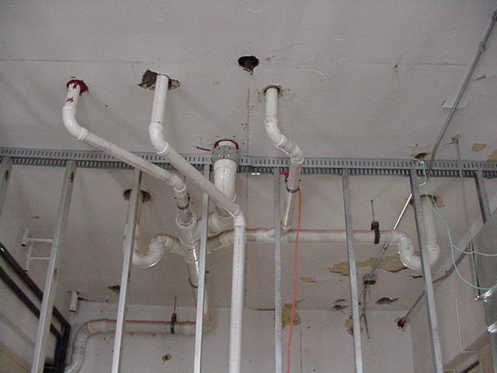


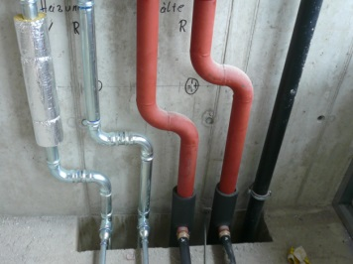


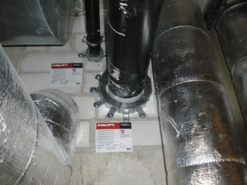






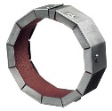
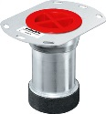
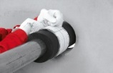
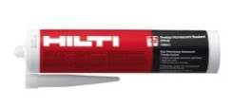
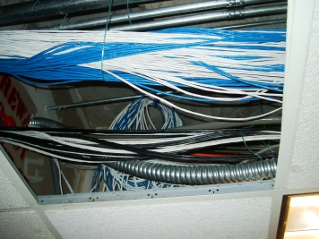
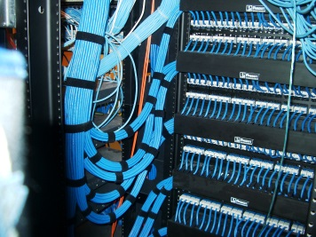
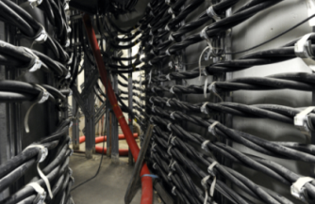



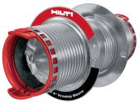
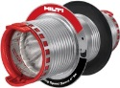
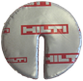
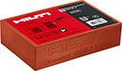
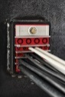
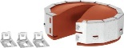
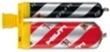
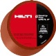
Hilti : Firestop system solution
Plumbing (Potable, WW)
HVAC (Heating, Cooling)
Industrial
Building Services
Telecom/Data
Power & Industry
Notes:
Lets look at Hilti solution from trade applications
This slide is more related to MEPF consultant. After showing it, just ask about current method and Hilti solutions.

Slide 3
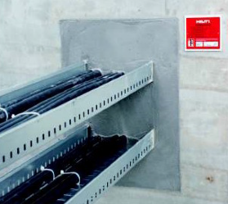
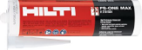

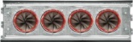
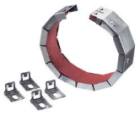


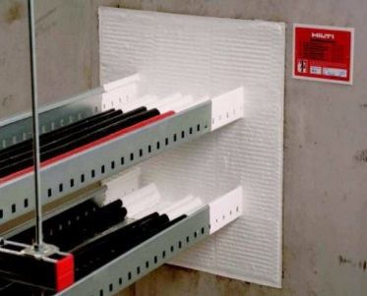
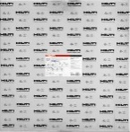
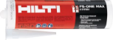
Firestop Applications - TP
Single small cables
Cable bundles
Cable trays/ Bus Bars
Ducts
Metal Pipes
PVC Pipes (Combustible)
Mixed Penetrations
Floors
Wall
Walls
CFS DISC, CP 606, CP 636, Composite Board, Speed Sleeves, CP 644, FS One Max, CFS BL
Notes:
After Trade applications, lets look at from application wise solution.

Slide 4
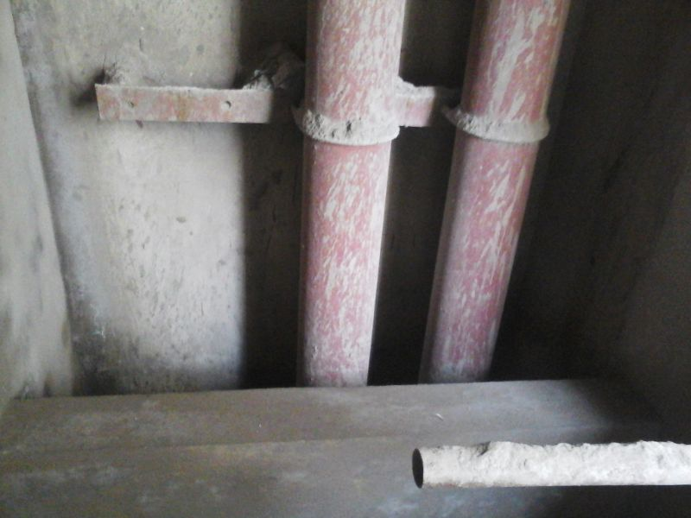
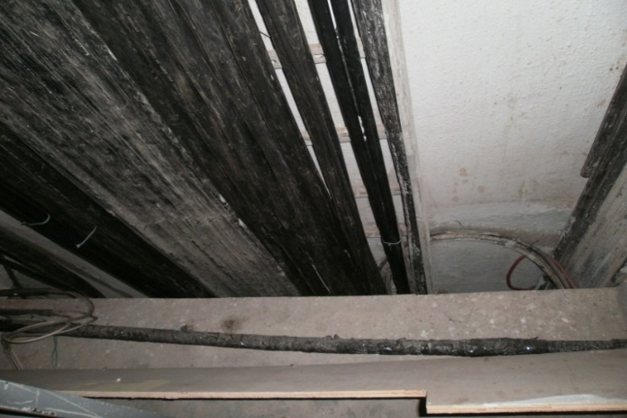
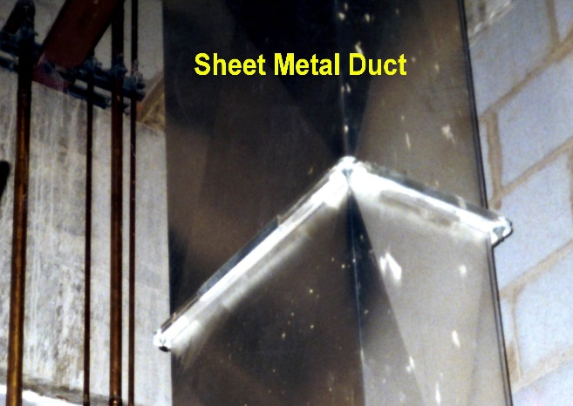
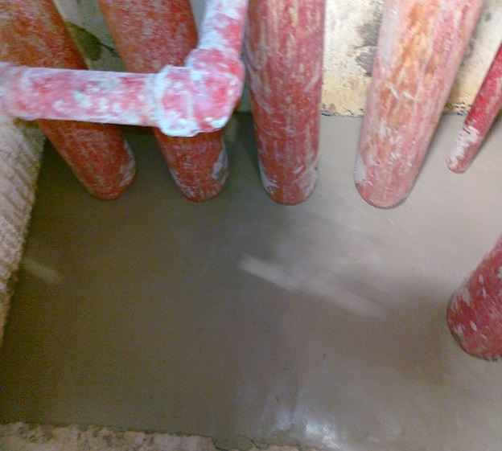
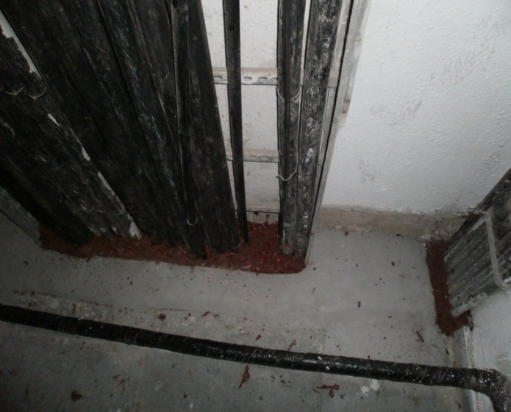
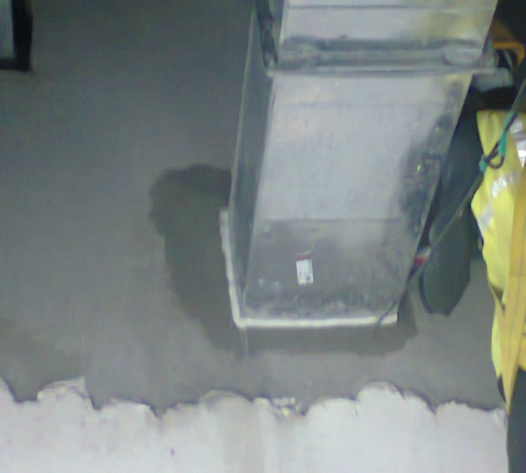
Hilti System Solution (Floor)
Pipes (Blank Openings)
Cables (Blank Openings)
Ducts (Blank Openings)
Pipes (with Firestop)
Cables (with Firestop)
Ducts (with Firestop)
Notes:
Blank openings Vs Proper fire stooping applications wrt Pipes, Cables & Ducts

Slide 5
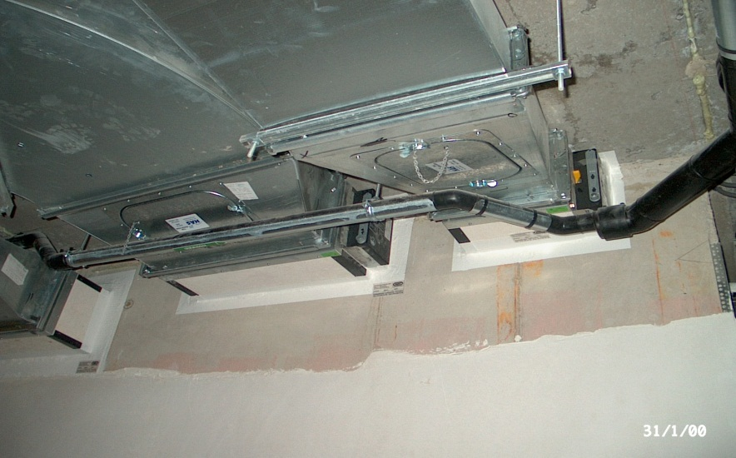
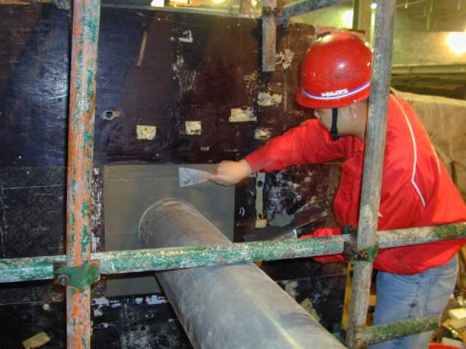
1. HVAC TRADE
Services : HVAC Duct
Solution :
Hilti Mineral Wool Board System
CP 606 with Mineral wool as backing material
Services : Chilled Water Pipe/Copper Pipes
Solution :
CP 636
NOTE : For Approvals , Please refer FSM or contact Firestop specialist.

Slide 6
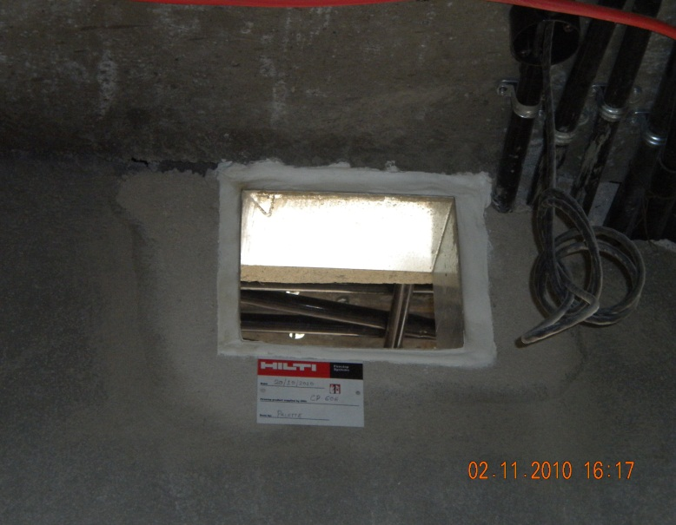
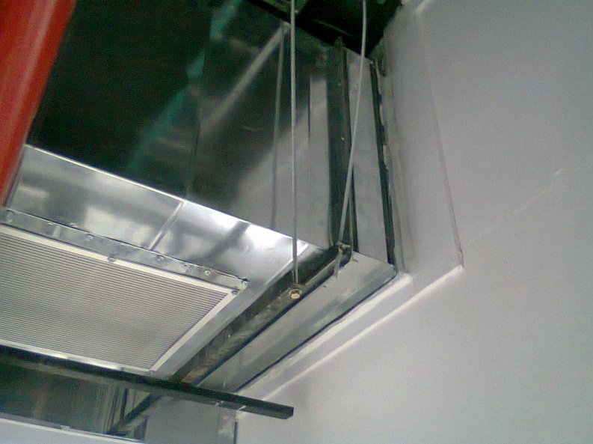
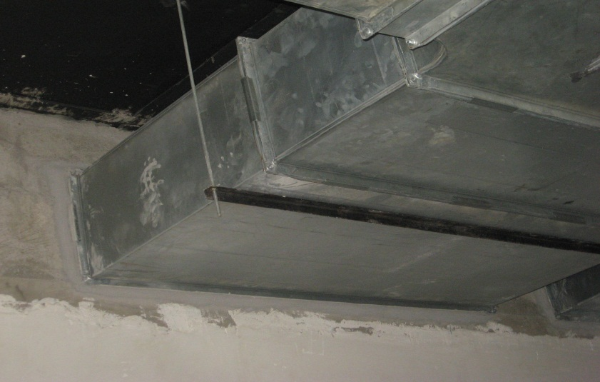
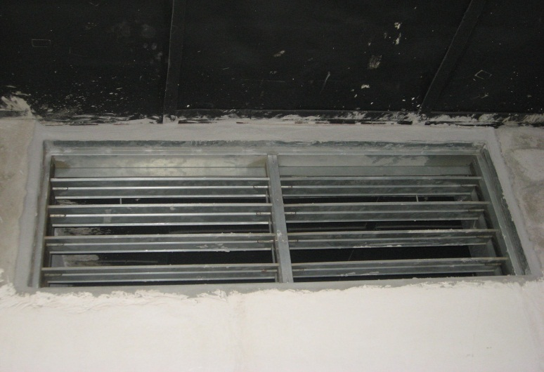

Slide 7
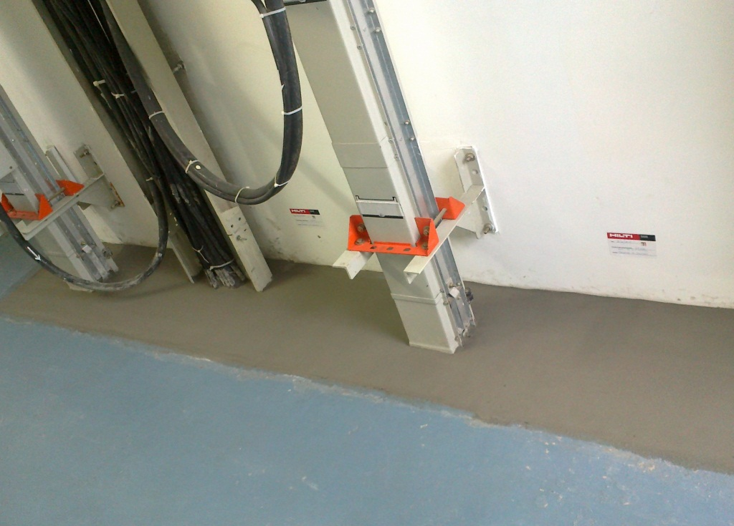
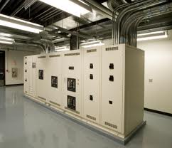
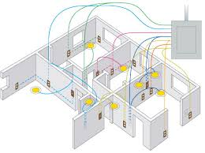
2. ELECTRICAL TRADE

Slide 8
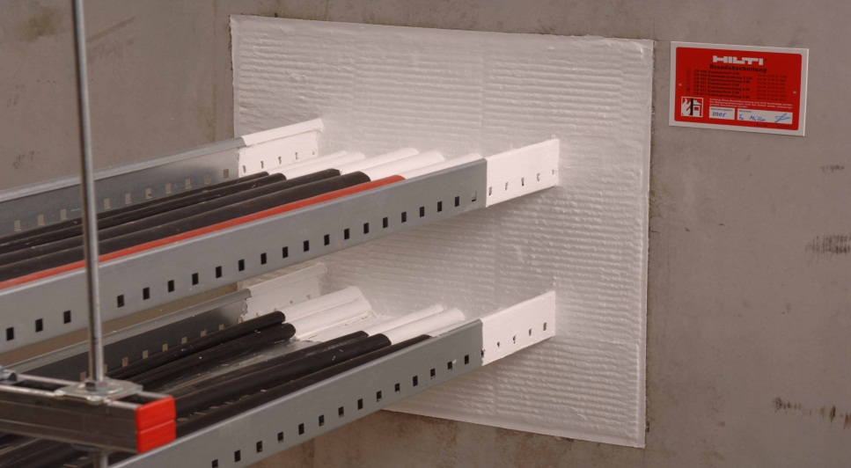
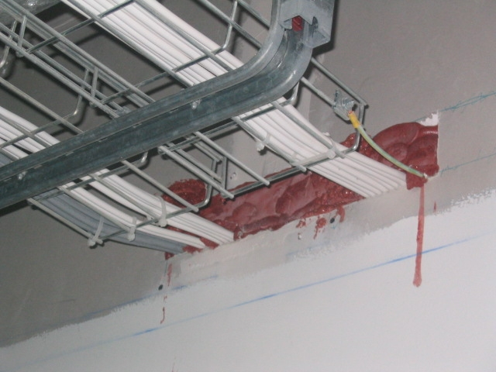
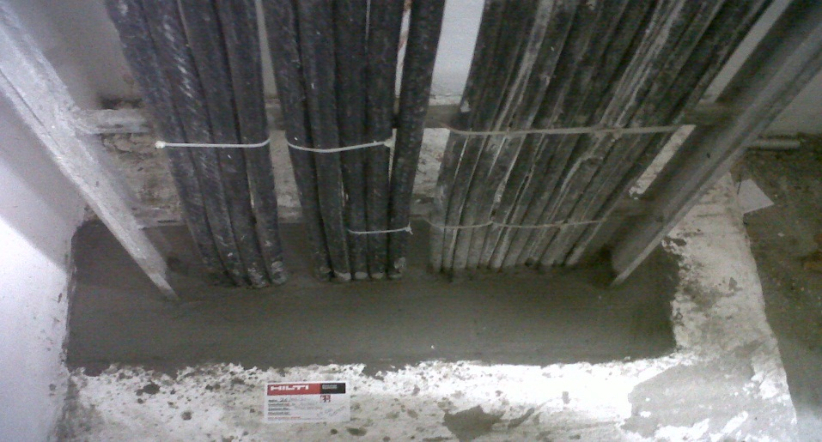
ELECTRICAL TRADE
Services: Cable Tray
Solution :
Hilti Mineral Wool Board System
CP 636
CP 620
NOTE : For Approvals , Please refer FSM or contact Firestop specialist.

Slide 9
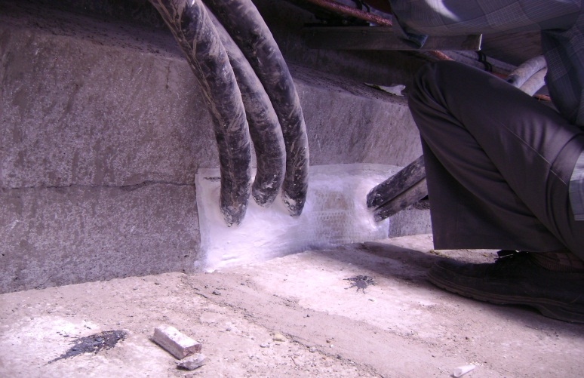
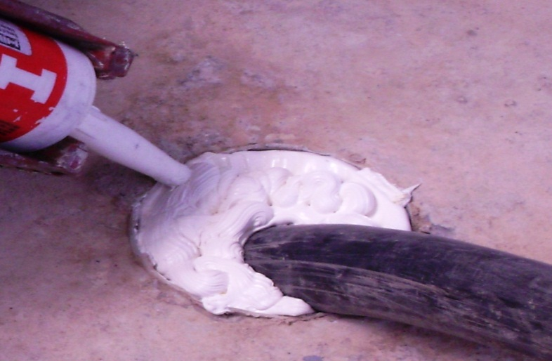
ELECTRICAL TRADE
Services : Cables
Solution :
CP 636
FS One
CP 620
HMWB
NOTE : For Approvals , Please refer FSM or contact Firestop specialist.

Slide 10
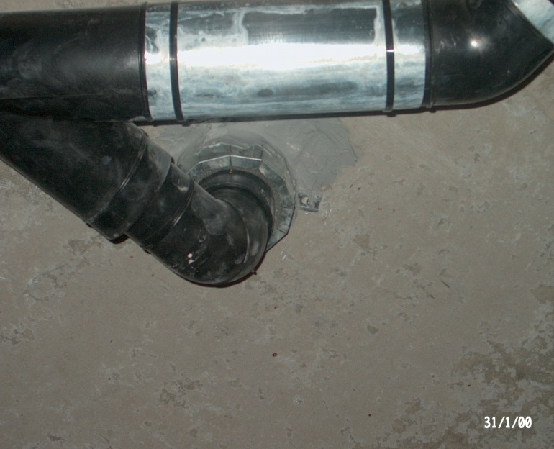
3. PLUMBING SHAFT
Services : Ceramic Pipes
CP 636
Services : Plastic Pipes
1)CP636 + FS One
2)CP636 + Wrap
3)CP636 + Collar
NOTE : For Approvals , Please refer FSM or contact Firestop specialist.

Slide 11
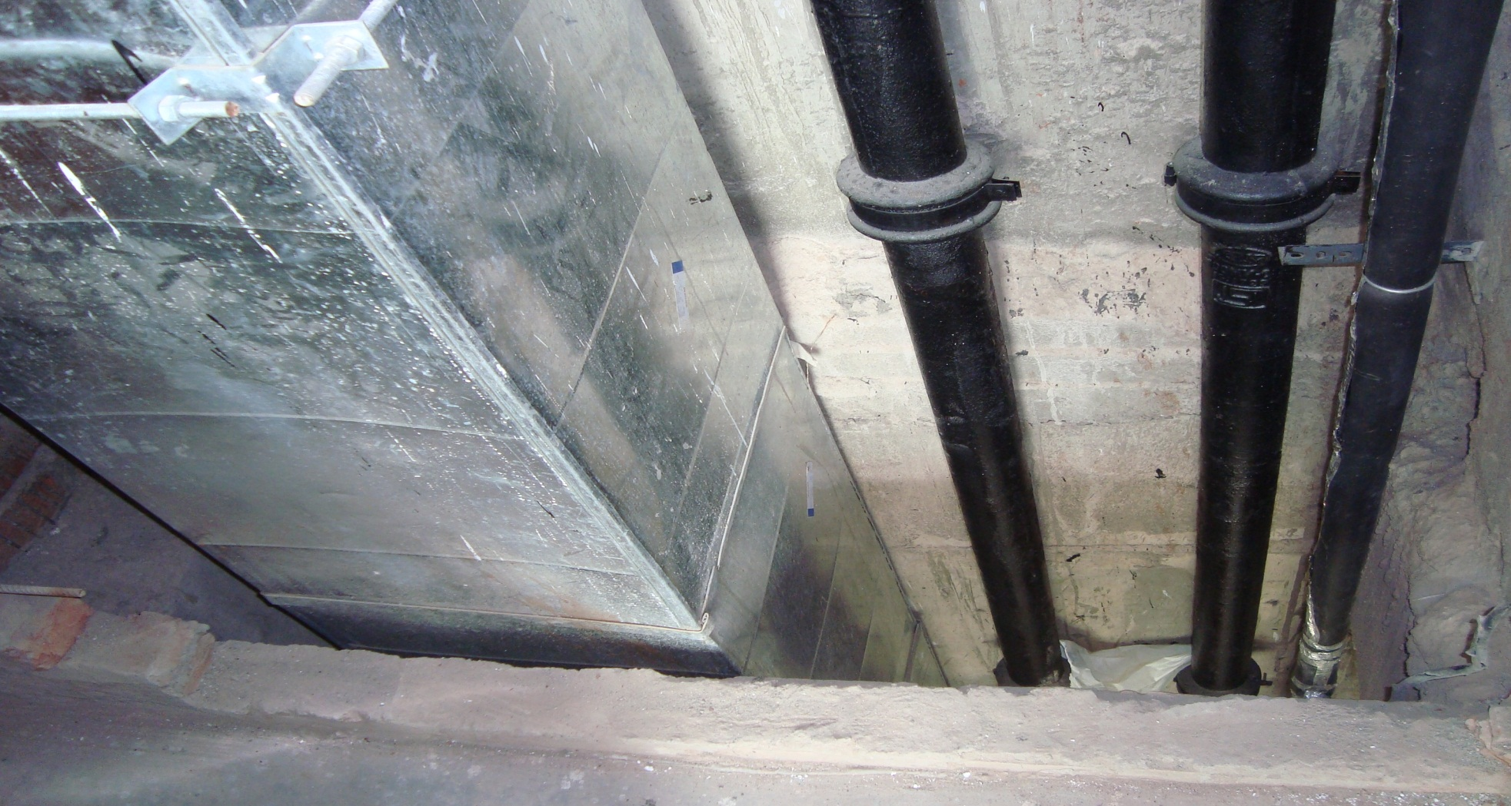
4. HVAC & PLUMBING

